Slide 1

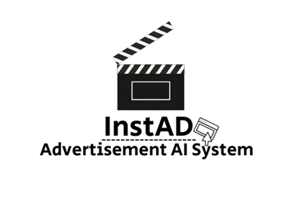

A Capstone Project
InstaAd
AI-Based Advertisement Generator
By:
Maor Siboni & Daniel Ayash
Supervisor:
Dr.Zakharia Frenkel

Slide 2
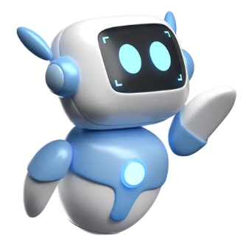
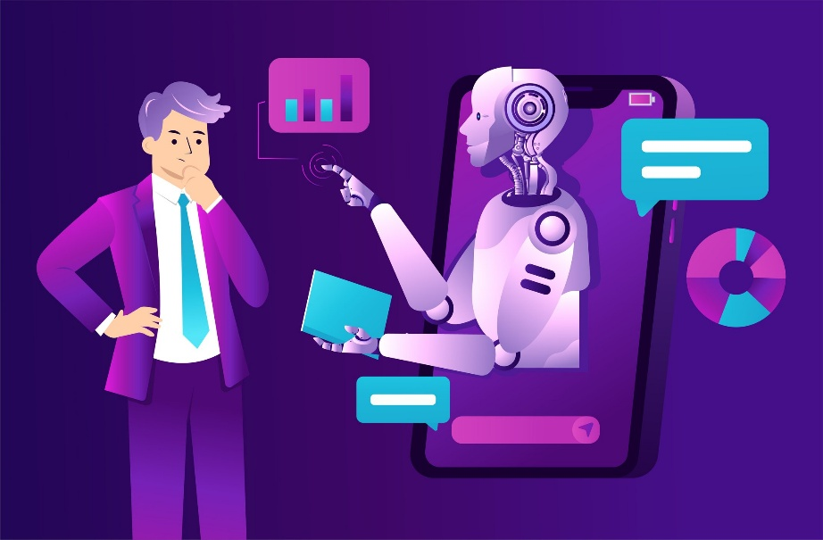
AI In Modern Advertising
AI in advertising refers to the use of intelligent algorithms to create, analyze, and optimize promotional content.
The rise of generative AI has opened new opportunities for creative, automatic ad generation without human intervention
Artificial Intelligence enables the creation of ads tailored to each individual

Slide 3

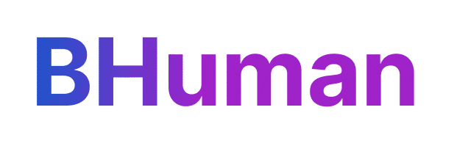
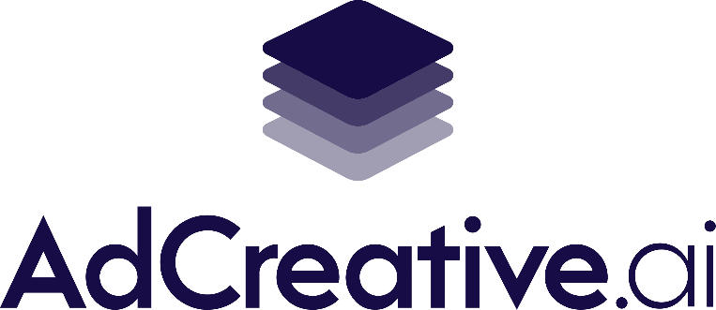
The Current Situation
There are AI-based advertising tools that similar to our project that are already in use
They allow automatic generation of ads using templates and personalization APIs.
Common in large companies, these tools are powerful but not accessible to all.
These tools streamline ad creation by combining user inputs with automated design and messaging generation
Typically built for marketing teams and are optimized for large-scale commercial use

Slide 4

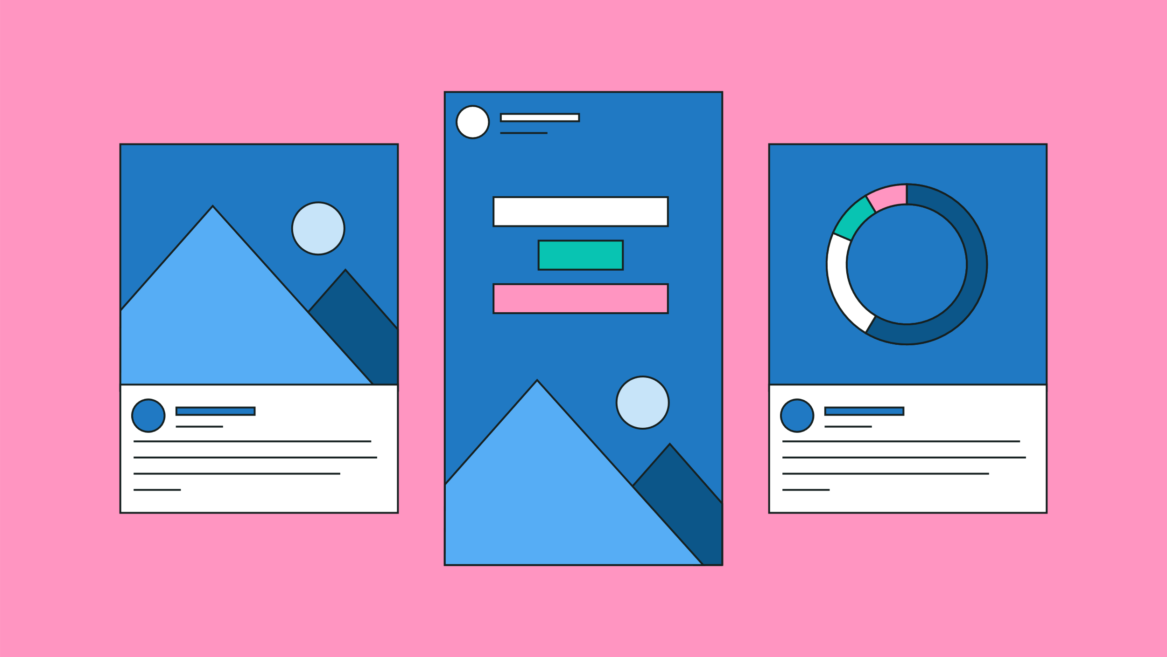
The Problem
Existing solutions are not designed for non-technical users.
Ads often look generic and lack originality.
Tools don’t learn or adapt to a user’s preferences.
Often come with high subscription costs, making them inaccessible to small businesses
There is a clear need for a platform that is
More intuitive
More flexible
More personalized

Slide 5
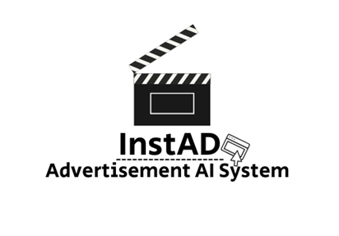

Our Solution -> A Simpler Way To Create Ads
A desktop application that allows users to create complete advertisements using natural language only.
Designed for non-technical users, no templates, no editing skills, no complex steps.
The user types a short idea or request – the system automatically generates the full ad (text, visuals, or video).
Personalized experience that adapts to the user over time.
No cost compared to other high-priced applications
Fast, simple, and creative ad generation – from idea to result in one click.

Slide 6

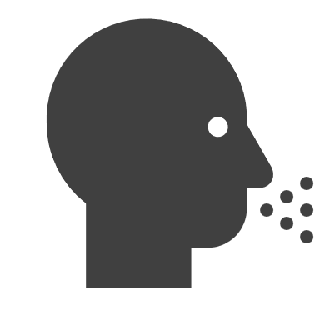

The Needs & Who Will Benefit
Our Team Style
Get a modern PowerPoint Presentation that is beautifully designed. I hope and I believe that this Template will your Time.
Small Business Owners
Who want to create ads quickly without hiring designers or marketers
01
02
Independent Creators
Looking for simple tools to promote their products or services
Non-Technical Everyday Users
Who find existing platforms too complex or expensive
03
04
Marketing Students And Freelancers
Who want fast, creative ad generation without deep technical

Slide 7


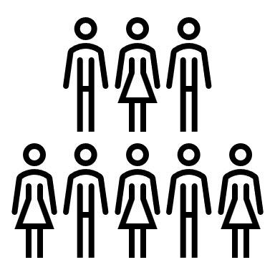
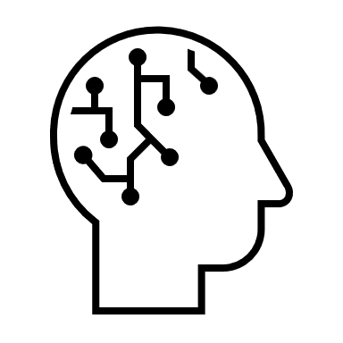

Project Goals
Functional Simplicity
Develop a desktop application that generates personalized advertisements from natural language input
Accessibility For All
Make ad creation fast, intuitive, and accessible to non-technical users and small businesses
Full AI Automation
Integrate advanced AI tools to automate the entire creative process: idea, design, and delivery
Modular & Maintainable Architecture
Design a system that’s easy to update and expand in the future

Slide 8
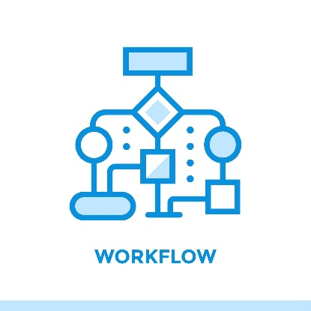
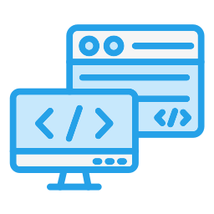
Technical Preview
Frontend (GUI) Built with a GUI framework on PyQt5, Organized into login, registration, ad generation, and saved ads screens. Styles and icons folders ensure design consistency. All actions send HTTP requests to the backend.
Backend (FastAPI): Handles authentication, ad requests, and data management. Connects to MongoDB with two collections: user info & saved ads. Controllers act as the bridge between the GUI and backend.
AI Integration: Backend communicates with external AI APIs for ad creation. For recommendations, keywords are retrieved from the database to generate personalized ads
Data Flow: User → GUI → FastAPI → MongoDB/AI API → Result back to GUI. Save/View/Delete ads managed directly through MongoDB via API routes.

Slide 9

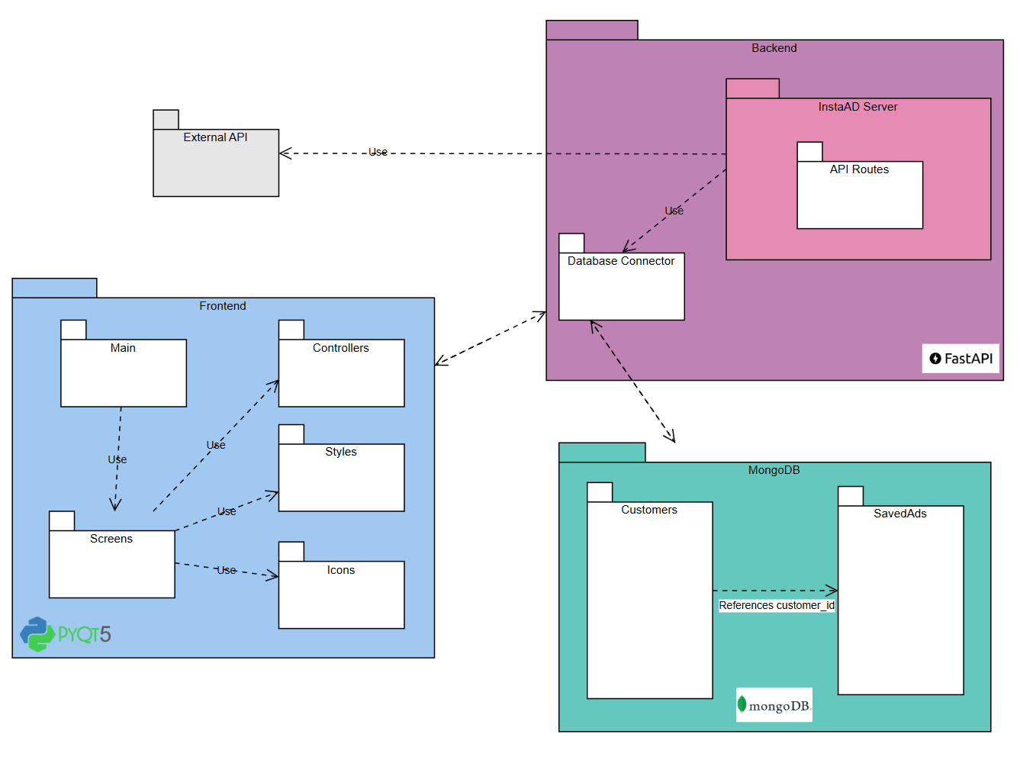
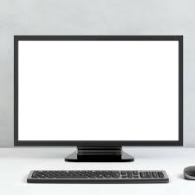


Proposed
Architecture

Slide 10
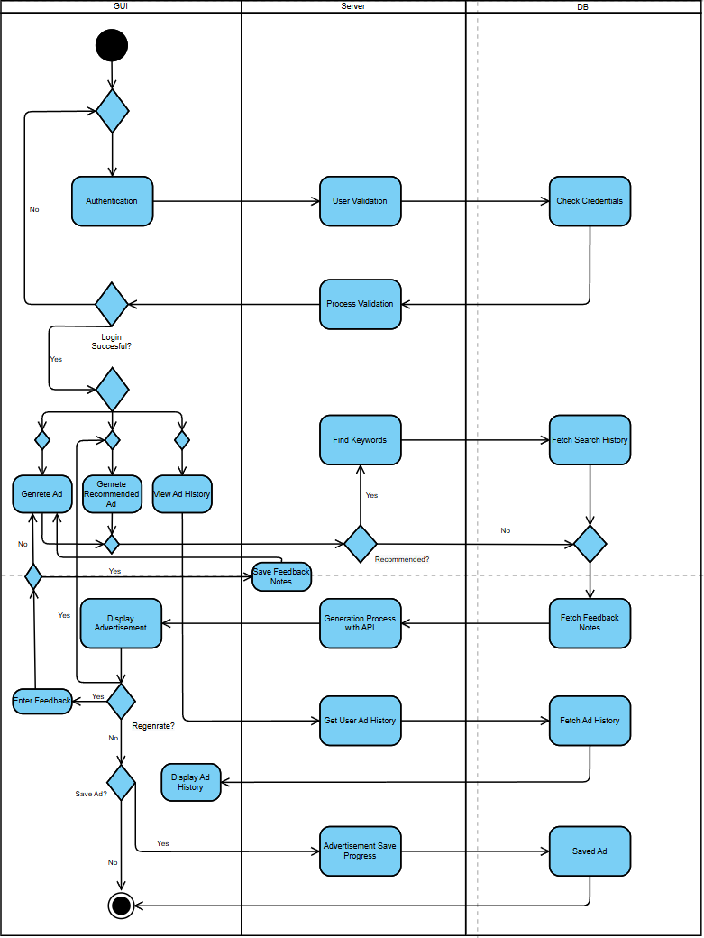
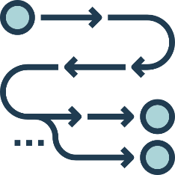
Activity Diagram
Illustration of the main flow of
our InstaAd application

Slide 11
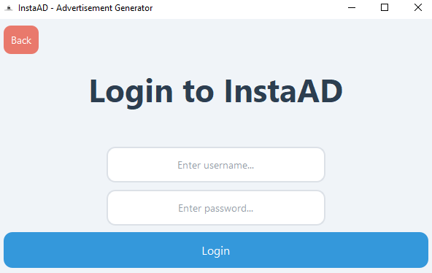
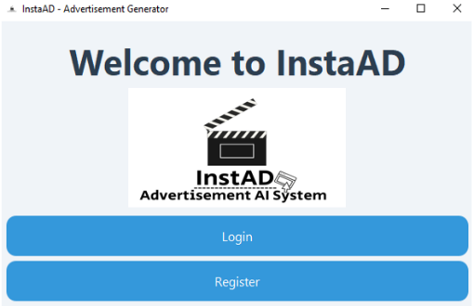
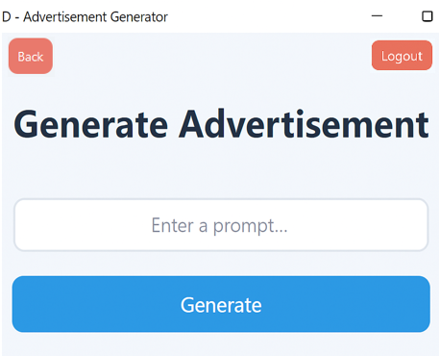
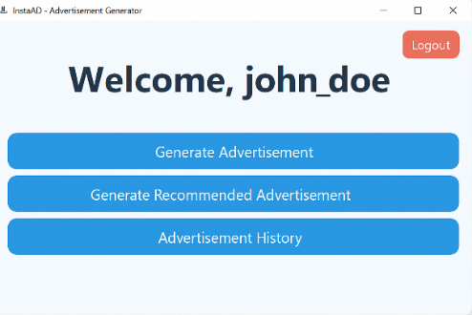
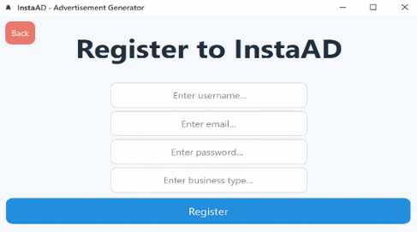
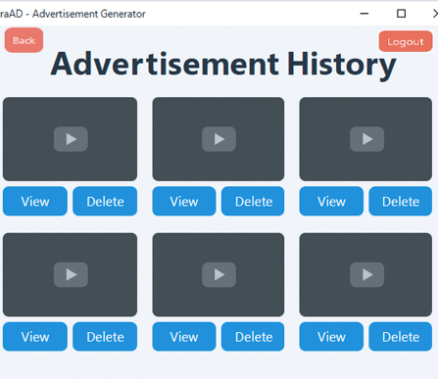
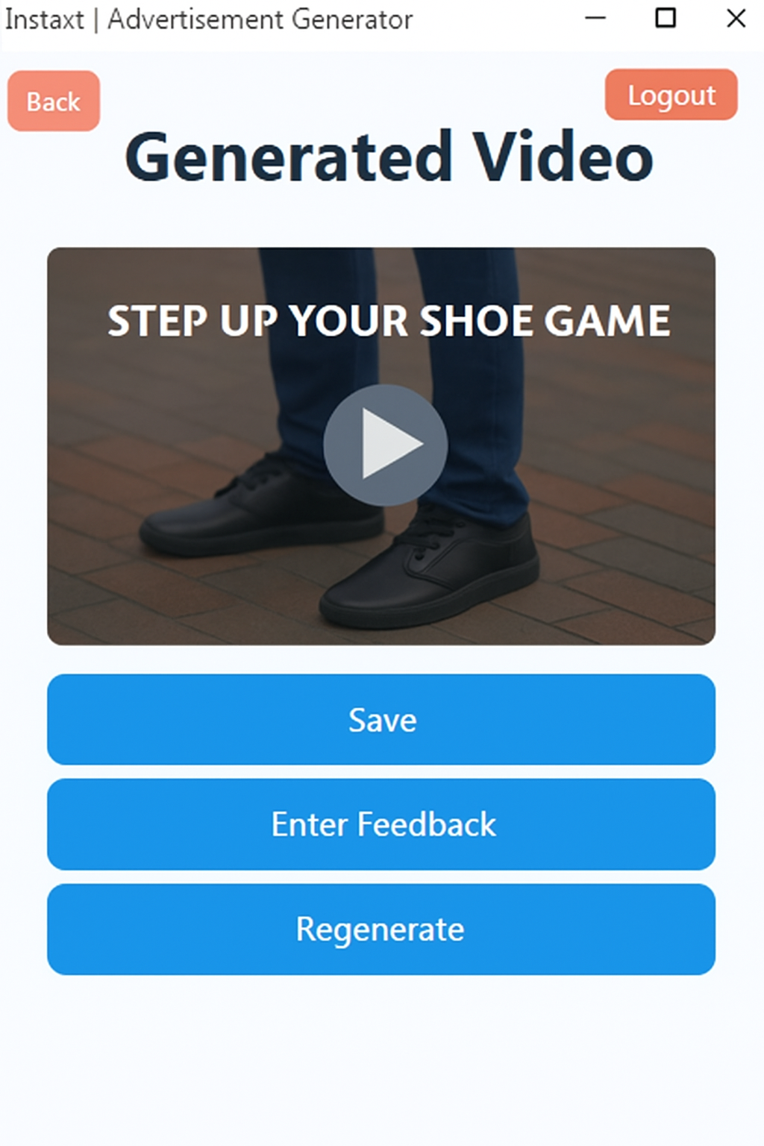
App Interface

Slide 12
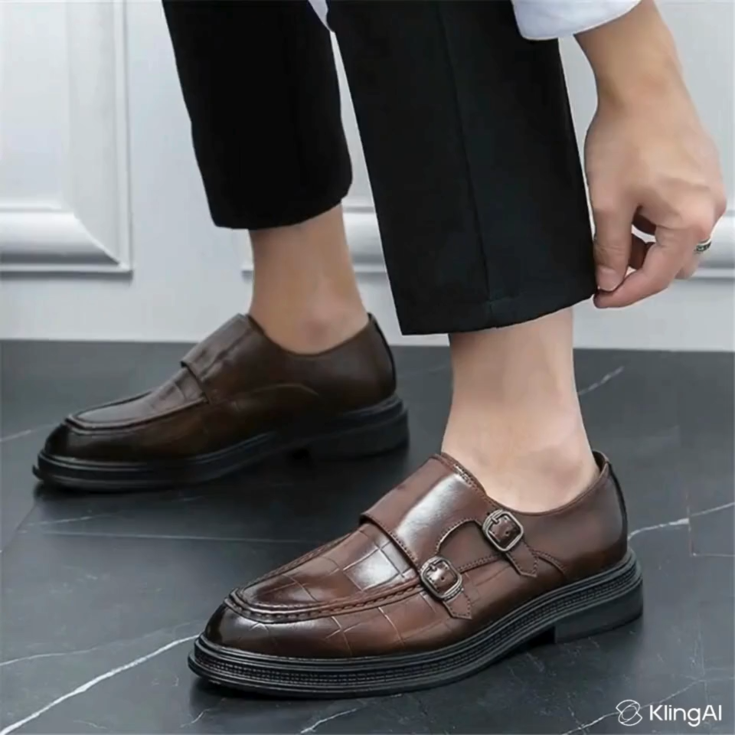
Sample AD

Slide 13
Expected Results
Personalized Output
Ad results and variety will improve over time through user history and preferences
Speed and Efficiency
Complete ads can be generated in less than one minute from a simple prompt
Cost & Time Savings
Users will save time and money by generating ads without hiring designers or agencies or paying for website subscription
Accessibility
Can be accessed from any regular PC and used by anyone with basic technical knowledge

Slide 14
How success will be measured:
Usability
Speed
Users can create full advertisements without external help or training
Advertisement generated in a reasonable amount of from prompt to output
Output Quality
System Stability
Generated ads are relevant, visually appealing, and consistent with the prompt
No critical crashes or bugs during regular use

Slide 15
Evaluation Matrix and expectations:
Evaluation Aspect | Goal Description | Target Accuracy / Success Rate
Ad Relevance | Generated ad correctly matches user prompt and intent | 90%
Personalization Accuracy | System learns and adapts to user preferences effectively | 85%
Visual / Design Quality | Ads look professional and appealing (based on user ratings) | 85%
NLP Processing Quality | Prompt is correctly tokenized, cleaned, and enhanced | 90%
Generation Speed | Ad created within acceptable response time (<45 sec) | 95%
User Satisfaction | Positive feedback / user willingness to reuse | 90%

Slide 16
Security & Privacy
Expected
Challenges
Protecting user data, login credentials, and preventing malicious input is essential
Interaction Design Balance
Balancing simplicity for beginners with flexibility for advanced users is a key challenge
Response Time
Generating images, videos, or voices can take time and impact the user experience
API Usage & Cost
Using external AI services involves rate limits and rising costs as the system scales

Slide 17
Thank You

